Slide 1
Chicago
STARS Management
Maria Schroeder, Jesse Smerechniak, Victoria Jiaras, Alex Perez, Christian Ortega, Zachary West, Gabe Bostick
Mentor: Lierin Peña from Mick Management

Slide 2
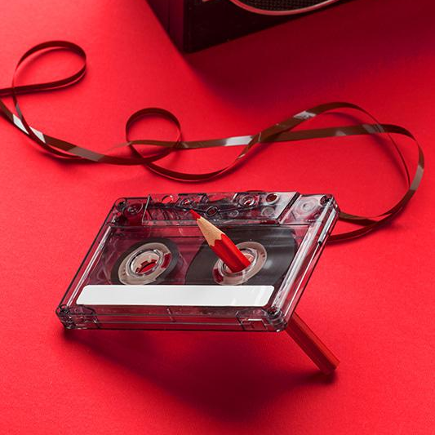
Artist Management - Final Project

Slide 3

Management Company Overview
Chicago STARS Management
Building profitable careers and awareness for growing “underdog” artists, that attract lifelong die-hard fans.

Slide 4
Staff Roles
MANAGER: GABE BOSTICK - Works directly with the artist to help guide them and provide them with what they need. Acts as the middleman between the company and the artist.
PR/MARKETING: ZACH WEST - Cultivates an image and a marketing scheme that maximizes the accessibility of the band, and maximizes the amount of money the band can make from merch.
CREATIVE DIRECTOR/MARKETING: VICTORIA JIARAS - Aims to create a sense of creative consistency to each task, bring ideas of what everything should end up looking & feeling like. Emphasis on this in our marketing.
SOCIAL MEDIA MANAGER: CHRISTIAN ORTEGA - Manages social media presence across multiple platforms.
TOUR MANAGER: MARIA SCHROEDER - Ensures that the tour is running smoothly, looks after tour finances, and is responsible for daily schedules.
BOOKING AGENT: JESSE SMERECHNIAK - Coordinates live performances for artists and handles communication with individual show venues.
LAWYER: ALEX PEREZ - Responsible for overseeing the legality of contracts and transactions between musicians and outside parties as well as copyright agreements.

Slide 5
Comprehensive Client Overview
Our client overview comes in the form of a concise one-sheet shown on the next slide.

Slide 6

Artist One Sheet

Slide 7
TOUR ROUTE
01
11
02
12
03
13
04
14
05
15
06
16
07
17
08
18
09
19
10
20
= off days
Seattle, WA - May 14th @ Chop Suey
Chicago, IL - June 3rd @ Lincoln Hall
Los Angeles, CA - May 18th @ Teragram Ballroom
Indianapolis, IN - June 4th @ Hi-Fi
San Francisco, CA - May 19th @ Rickshaw Stop
Columbus, OH - June 5th @ The Basement
Las Vegas, NV - May 20th @ Brooklyn Bowl
Philadelphia, PA- June 8th @ Johnny Brenda’s
Salt Lake City, UT - May 24th @ Kilby Court
New York City, NY - June 9th @ Bowery Ballroom
Denver, CO - May 25th @ Bluebird Theater
Boston, MA - June 10th @ The Sinclaire
Houston, TX - May 27th @ White Oak Music Hall
Washington, D.C. - June 11th @ Union Stage
Dallas, TX - May 28th @ Club Dada
Richmond, VA- June 16th @ The Broadberry
New Orleans, LA - May 29th @ Tipitina’s
Atlanta, GA - June 17th @ Center Stage
Kansas City, MO - June 1st @ RecordBar
Nashville, TN - June 18th @ Basement East
Capacity: 400 - 800

Slide 8
TOUR BUDGET*
$1,500
$8,500
$3,000
*ESTIMATES
$2,000
MERCH
MEALS
GAS + LODGING
INSURANCE
ROUGH TOTAL: $15,000

Slide 9
PROPOSED INCOME*
$10,000 or 85%
80% - 20%
Ticket Sales
*ESTIMATES
GUARANTEE or NBOR
MERCH
GENERAL and VIP
net box office receipts
artist venue
80% - hall fee, credit card fee, etc
General: $20-$30
VIP: $40-50

Slide 10
TICKET INCOME
10%
5%
5-10%
BOOKING/PROCESSING FEES
TAXES
VENUE FEES
ARTIST TEAM
MANAGER: 20%
BOOKING AGENT: 10%
ATTORNEY: 5%
BUSINESS MANAGER: 5%
90%
10%
ARTIST TEAM
PROMOTER

Slide 11
MERCH BREAKDOWN
T-SHIRTS
POSTERS
CDS
$20
$25
$15
VINYL
STICKERS
MASKS
HANDWRITTEN LYRIC SHEET
$25
$10
$8
$20

Slide 12

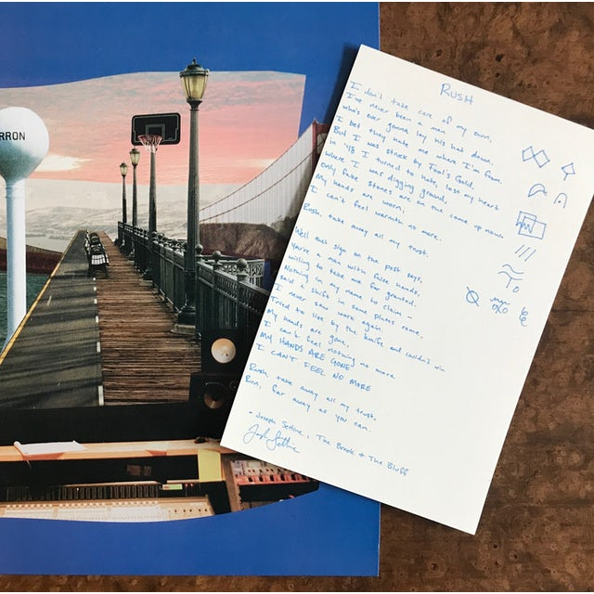
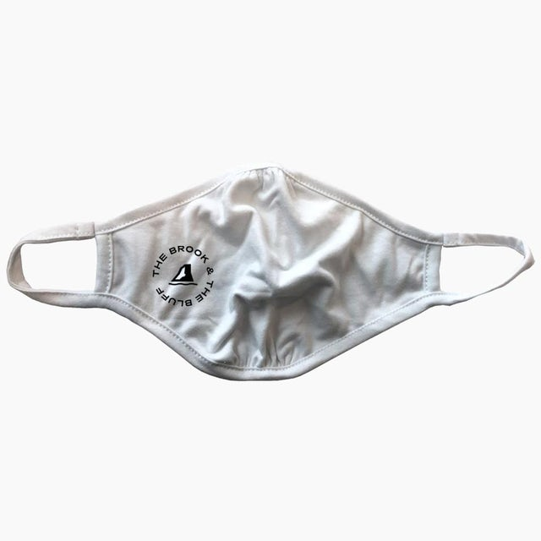
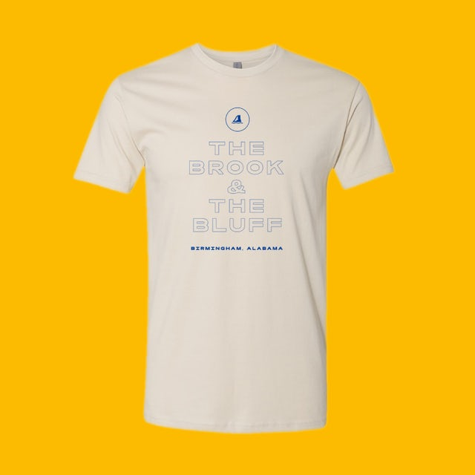
MERCH DESIGNS
POSTERS
HANDWRITTEN LYRIC SHEET
T-SHIRTS
FACE MASKS

Slide 13
MARKETING PLAN
three phases
Social Media:
Instagram ads, Facebook ads, Twitter ads
Print:
Posters around Nashville, local newspaper ads
TikTok:
Clip of a song to make a ‘sound’ & make a video of the band members doing something to the sound,
Hope sound gets traction...
PSA (radio):
Collaboration with #Save Our Stages
Virtual Yard Sale
Pop-up in-person Yard Sale Event in Nashville

Slide 14
PHASE ONE: Marketing for Release of Yard Sale Side B
TikTok Release: 2 months before release
Budget: free
Social Media Ads Release: 2 months (same time as TikTok)
Budget: $1,500
PSA: 1 month right before release
Budget: $989
Print: 1 month right before release
Budget: $700

Slide 15
PHASE TWO: Virtual Yard Sale
DESCRIPTION OF EVENT:
When:
One month before Side B comes out
Website open for a week long
What:
Sell merch online here
Videos of the band performing playing as people shop
Songs playing on the website as people shop
MARKETING FOR EVENT:
Social Media Ads Release: 2 weeks before the event
BUDGET: $750
Promotional Tik Tok Post: 2 weeks before the event
BUDGET: free

Slide 16
PHASE THREE: Pop-up in-person Yard Sale in Nashville
MARKETING FOR EVENT:
PSA on Local Radio Stations: In collaboration with #SaveOurStages
WHEN: 2 days before event (in attempt to keep the surprise factor)
BUDGET: $354
Print Posters around Nashville: 2 weeks before the event
WHEN: 2-3 days before event
BUDGET: free
DESCRIPTION OF EVENT:
WHEN:
On day of release of Side B
Supposed to feel like a ‘secret’ pop-up
WHAT:
Merch for sale
CD/vinyl for sale
Band performs a couple songs from new release Drinks / food (small amount)
Will resemble an traditional yard sale
A bit more info on this in our big idea… stay tuned

Slide 17

Chicago Stars
Management
ONE BIG IDEA

Slide 18
Big Idea: Utilize the seasons
Actions
Desired Results
Make the album rollout Summer themed
Physical Yard Sale will be at a beach and have summer decorations
The merch and the album art will be
Being on more summer playlists
More merch sales
More people at the physical Yard sale events

Slide 19
THANK YOU!
DO YOU HAVE ANY QUESTIONS?

